Slide 1

Master of Computer Application
University Institute of Technology
Rajiv Gandhi Proudyogiki Vishwavidyalaya
A
Major Project
on
Age-Gender Detection
Presented By:-
Sushmita Singh
(0101CA211061)

Slide 2
Age and Gender Detection: Unveiling the Secrets of Caffe Models and OpenCV

Slide 3
Content
Introduction​
Pre-Trained Caffe Models​
OpenCV​
CNN​
Flowchart​
Steps Involved in Face Recognition.
Challenges in Age and Gender Detection​
Applications of Age and Gender Detection
Output​
Future Scope​
Conclusion​

Slide 4
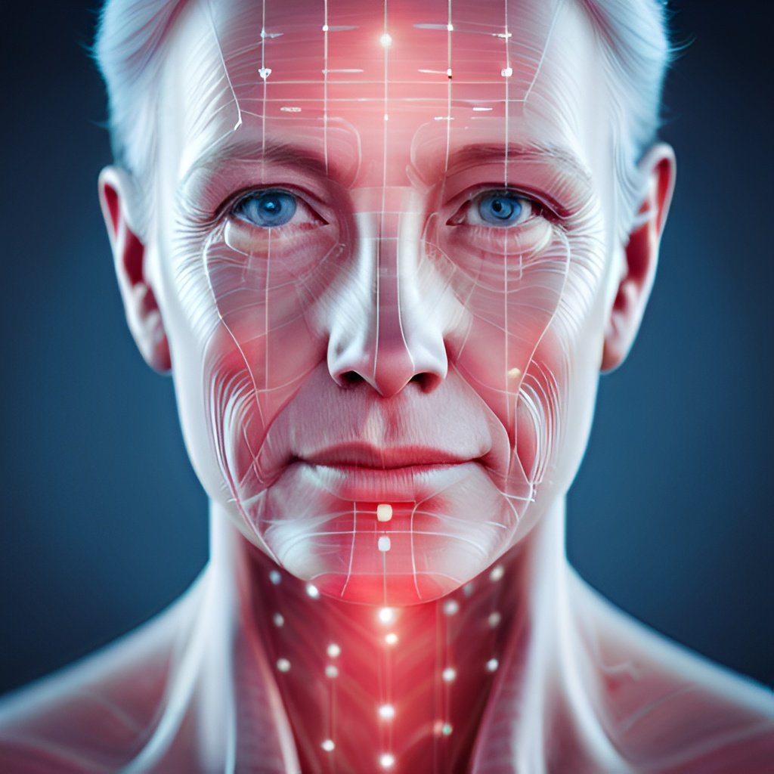
Introduction​:-
​
Age and gender detection is a crucial task in computer vision and has numerous applications in various fields. With the advancements in deep learning and computer vision, it has become possible to accurately detect age and gender from images and videos.​
​
In this presentation, I will discuss the use of pre-trained Caffe models and OpenCV for age and gender detection. I will also explore the challenges faced during the process and how they can be overcome.​

Slide 5

Pre-Trained Caffe Models​:-
​
Caffe is a deep learning framework that is widely used for image classification tasks. Pre-trained Caffe models are trained on large datasets and can be used for various computer vision tasks, including age and gender detection.​
​
Using pre-trained Caffe models for age and gender detection significantly reduces the time and resources required for training a model from scratch. Moreover, these models have high accuracy rates and can be fine-tuned for specific use cases.​

Slide 6
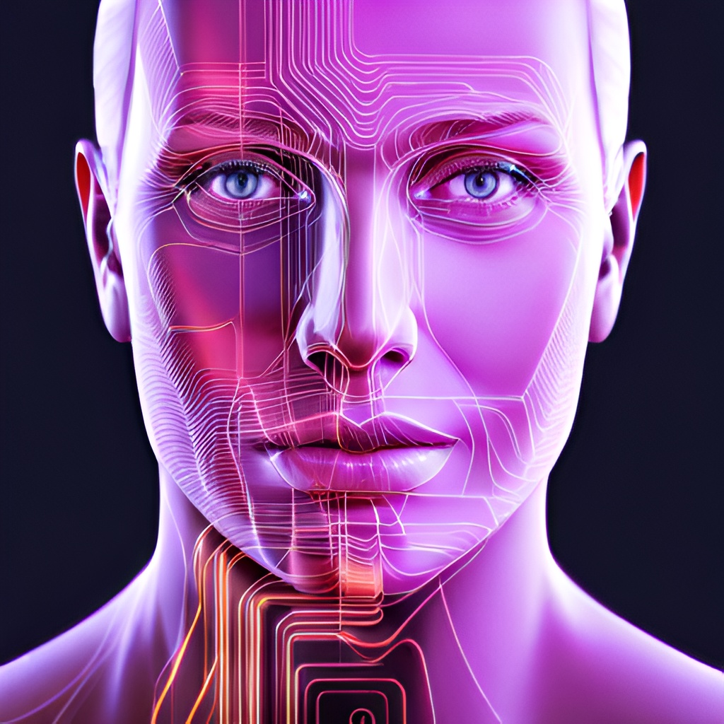
OpenCV​:-
OpenCV (Open Source Computer Vision) is an open-source library that provides tools for computer vision tasks. It has a vast collection of algorithms and functions that can be used for various tasks, including image processing, object detection, and face recognition.​
OpenCV provides a simple interface for integrating pre-trained Caffe models into applications. It also has functions for image preprocessing, which is essential for accurate age and gender detection.​

Slide 7
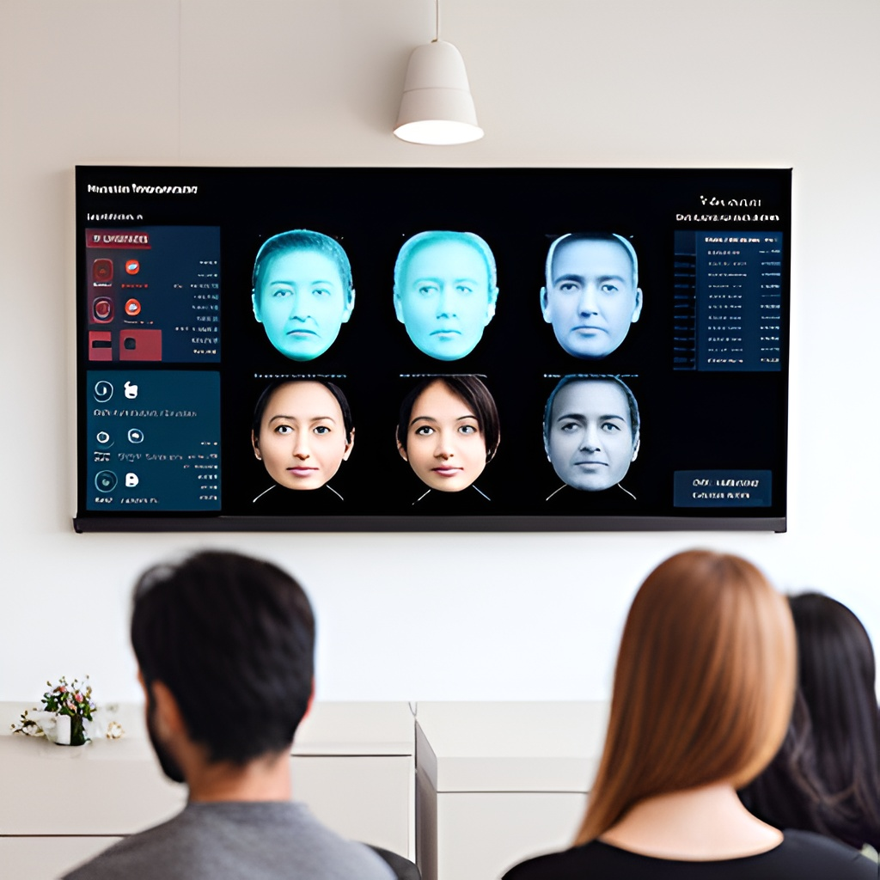
Convolotion Neural Network(CNN):-
A Convolution Neural Network. is a deep neural network (DNN) widely used for the purposes of image recognition and processing and NLP. Also known as a ConvNet, a CNN has input and output layers, and multiple hidden layers, many of which are convolutional. In a way, CNNs are regularized multilayer perceptrons.
The convolutional neural network for this python project has 3 convolutional layers:
Convolutional layer; 96 nodes, kernel size 7
Convolutional layer; 256 nodes, kernel size 5
Convolutional layer; 384 nodes, kernel size 3
It has 2 fully connected layers, each with 512 nodes, and a final output layer of softmax type.

Slide 8
Flowchart:-
Upload Image
Face Detection
Age and Gender Detection
Result

Slide 9
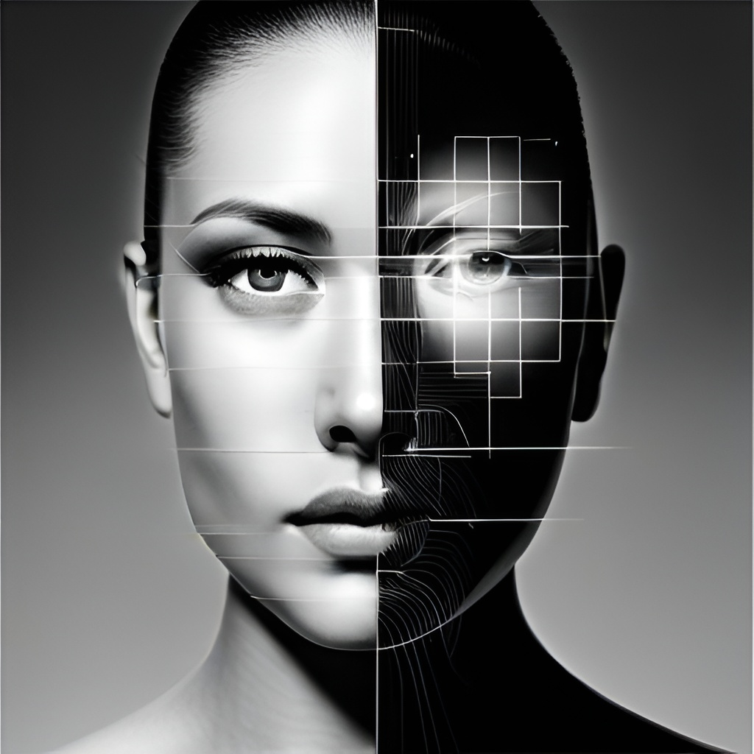
Steps Involved in Face Recognition:-
Detect faces: When given a frame/video, the CNN algorithm first detects for faces in each frame.
Classify into Male/Female: Once it find face in the ,the features of the face ae extracted, and the gender is determined using second layer of CNN.
Classify into one of the 8 age ranges: n the layer of CNN ,the age of the faces s determined and falls under either of the 8 age ranges(0-2),(4-6),(8-12),(15-20),(25-32),(38-43),(48-53),(60-100).
Put the results on the image and display it: The result is displayed on the fame containing the age range and gender using OpenCV. The resulting frame consists of a square box around the faces with the estimated gender and age.

Slide 10

Challenges in Age and Gender Detection:-
Despite the progress made in age and gender detection technology, there are still many challenges that researchers face. One major challenge is the lack of diversity in the datasets used to train these algorithms, which can lead to biases and inaccuracies in the results.
Another challenge is the ethical considerations surrounding the use of this technology, particularly in fields such as marketing and advertising where it could be used to target specific age or gender demographics. Researchers must navigate these complex issues while continuing to refine and improve the accuracy of their methods.

Slide 11

Applications of Age and Gender Detection
Age and gender detection have many applications in various fields. In marketing, it can be used to analyze customer demographics and tailor marketing strategies accordingly. In security, it can be used for surveillance and access control. In healthcare, it can be used for patient monitoring and diagnosis.
The accuracy and efficiency of OpenCV and pre-trained Caffe models make them ideal for these applications. They can be easily integrated into existing systems and can provide valuable insights and data.

Slide 12
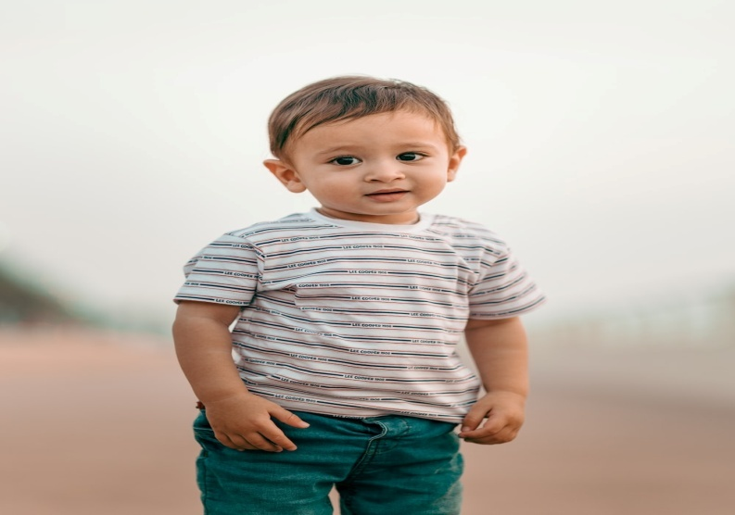
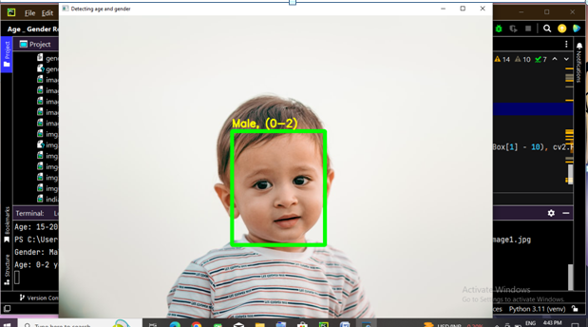
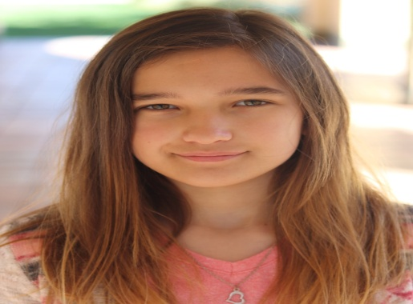
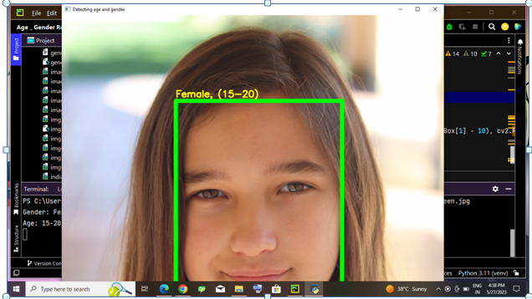
Expected Result
Output
Input

Slide 13
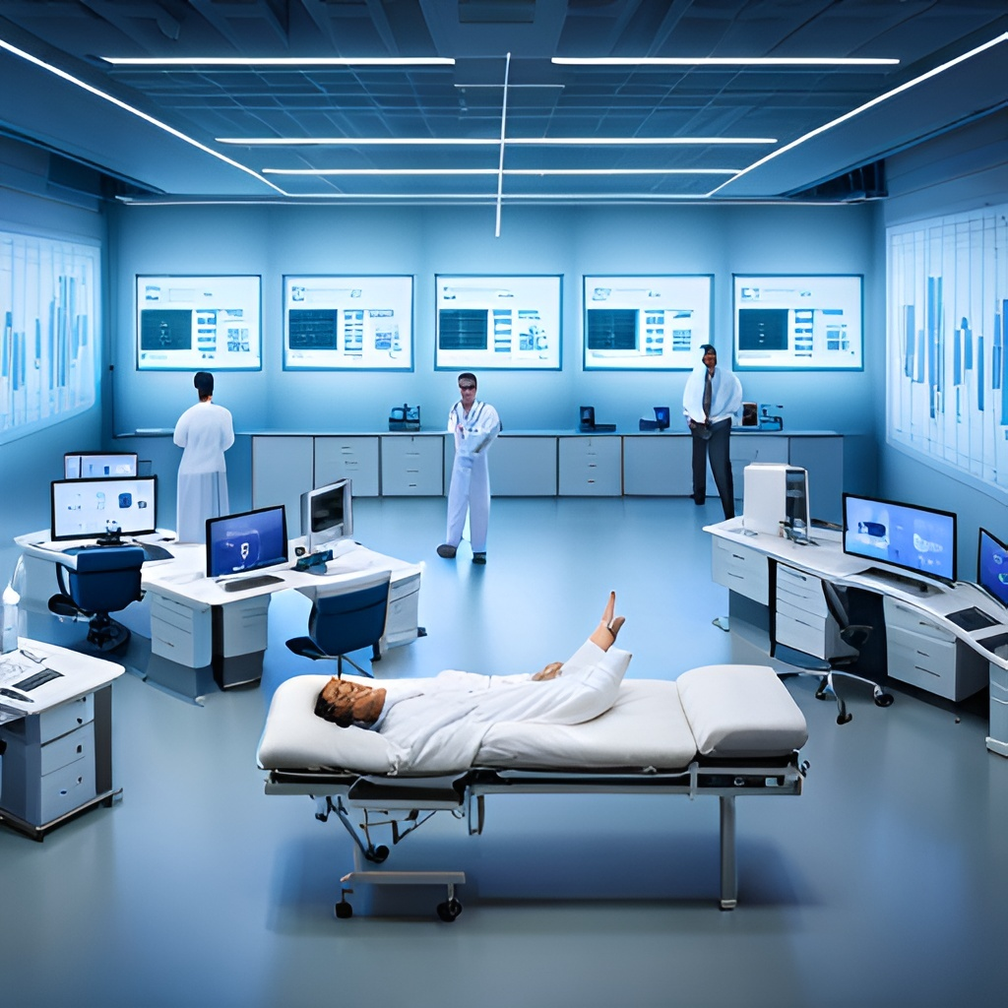
Future Scope:-
The potential for age and gender detection using OpenCV and pre-trained Caffe models is vast. As technology continues to advance, we can expect these models to become even more accurate and efficient. This will open up new possibilities for their use in various fields.
One area where we may see significant growth is in the development of personalized healthcare. By analyzing patient demographics and monitoring their health over time, healthcare professionals can provide tailored treatment plans that take into account factors such as age and gender. This could lead to better outcomes for patients and a more efficient healthcare system overall.

Slide 14

Conclusion:-
In conclusion, age and gender detection using OpenCV and pre-trained Caffe models is a powerful technology that has many applications in various fields. The accuracy and efficiency of the algorithms make them ideal for integration into existing systems. Fine-tuning the pre-trained models on specific datasets can improve their performance and provide more accurate results.
As technology continues to advance, age and gender detection will become even more important and will continue to play a crucial role in various industries.

Slide 15
Thank
You

